Slide 1
Placement Management
Submitted by
1.Mokshada R. Kolte
2.Pinal P. Dandgavhal
3.Unnati R. Kamble

Slide 2
Contents
Introduction
Software used
Modules
Front End
Back End
Use case diagram For Class
Output
Conclusion

Slide 3
Introduction
Job portals are sites where you can promote jobs and search for resumes. They are an important part of almost every hiring procedure, and using them efficiently will interpret into qualified candidates for moderately low costs. So, below we have listed some benefits for both recruiters and job seekers for using job portals to find a job and promote job opening for the specific companies.
Job seekers can easily contact an extensive collection of job vacancies through job search engines, at their phase. Away from that, most job portals have filters which help users slight down results. This trait makes it easier for job seekers to decide on a specific career. Equally, online job search sites can help employers pace up their hiring process. It would be easy for recruiters or hiring managers to verify job applications online than physically scan printed resumes. Hence, job portals help them save time and endeavour.

Slide 4
Software Used
Front END
JDK Software
JavaScript
HTML
MYSQL Database
Backend

Slide 5
Modules
There are Four module used in their project:-
1. Admin Module
2. Job Seeker Module
3. Recruiter Module

Slide 6
Front End
In the Front End There are two Software are used to design our project:-
HtML5- show the pages in the browser in Html format.
CSS - CSS are used to design our project in proper format with proper style, alignment, border, show images.

Slide 7
Back End
In the Back End we used Spring tool Suite (STS) to write our coding part.
We used the combination of Languages-
Java-For Coding part.
Hibernate- Mapping.
JPA Repository
Spring MVC- for used model and views part.
Mysql J connector- my sql is used to storing the data in table format.

Slide 8
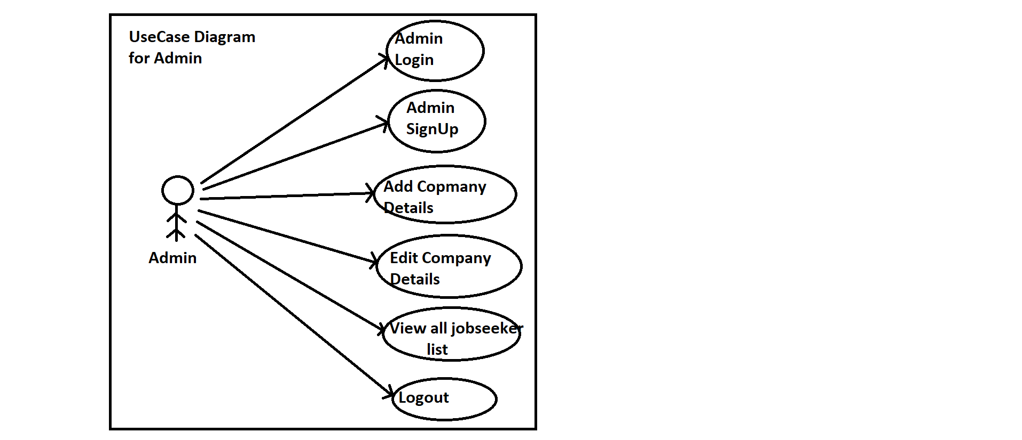
Use Case Diagrams
Admin Module-

Slide 9
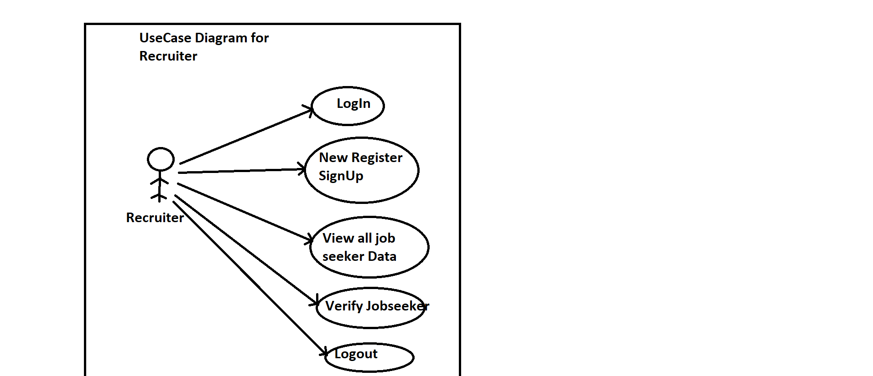
Recruiter Module

Slide 10
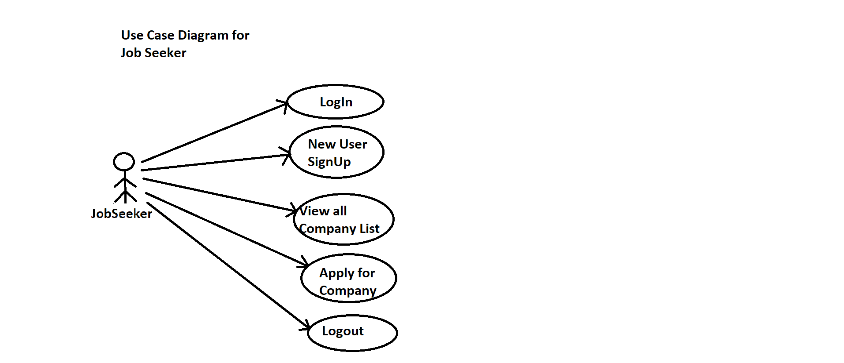
Job Seeker Module

Slide 11

Output
First title page

Slide 12

Job Seeker Page

Slide 13

Recruiter Page

Slide 14
Conclusion
From a proper analysis of positive points and constraints on the component, it can be safely concluded that the product is a highly efficient GUI based Component . This component can be easily plugged in many other system. Also the component is user is user friendly. Generally the TPO’s of the Companies has to face problems in management of the Jobseeker information. This all information has to be managed manually. So, there is a need to develop a system that can solve the mentioned problem. This software comes with just that solution.

Slide 15
Thank You!

